Slide 1
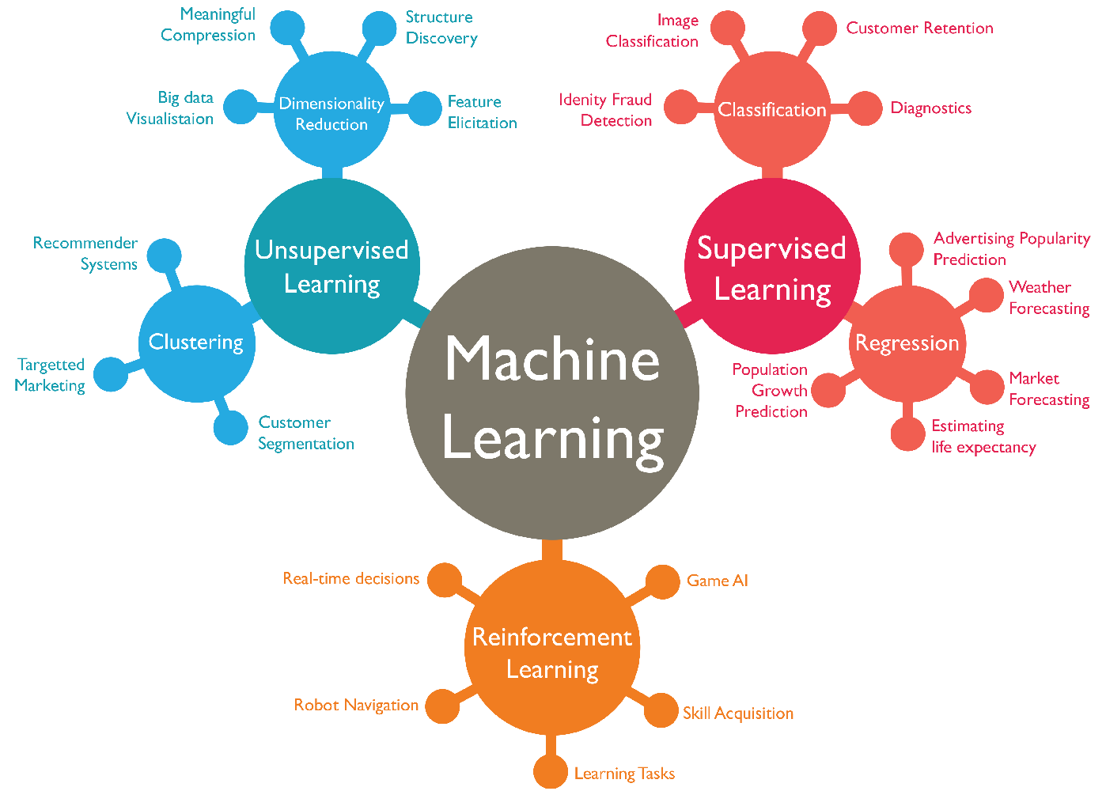
ISA 630 – Machine Learning for Business Applications
Machine Learning for Business Applications
Overview of the Course

Slide 2
Instructor
Dr. Waldyn Martinez
Office: 2020
Email: martinwg@miamioh.edu
Office Phone: 513.529.2154
Area of Expertise: Dr. Martinez' research is focused on the area of Statistical Machine Learning, specifically in the theory and applications of ensemble, hybrid and deep learning algorithms.

Slide 3
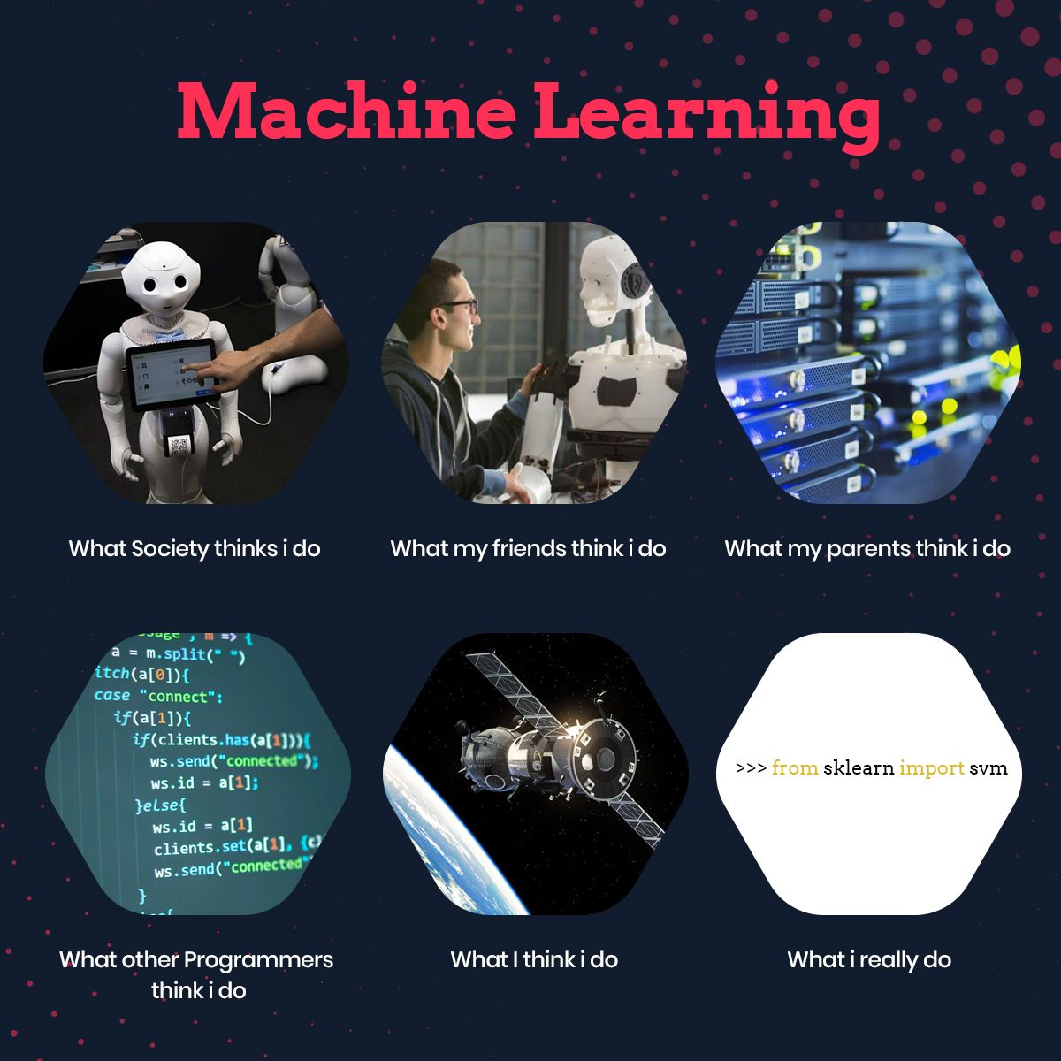
What is Machine Learning?

Slide 4

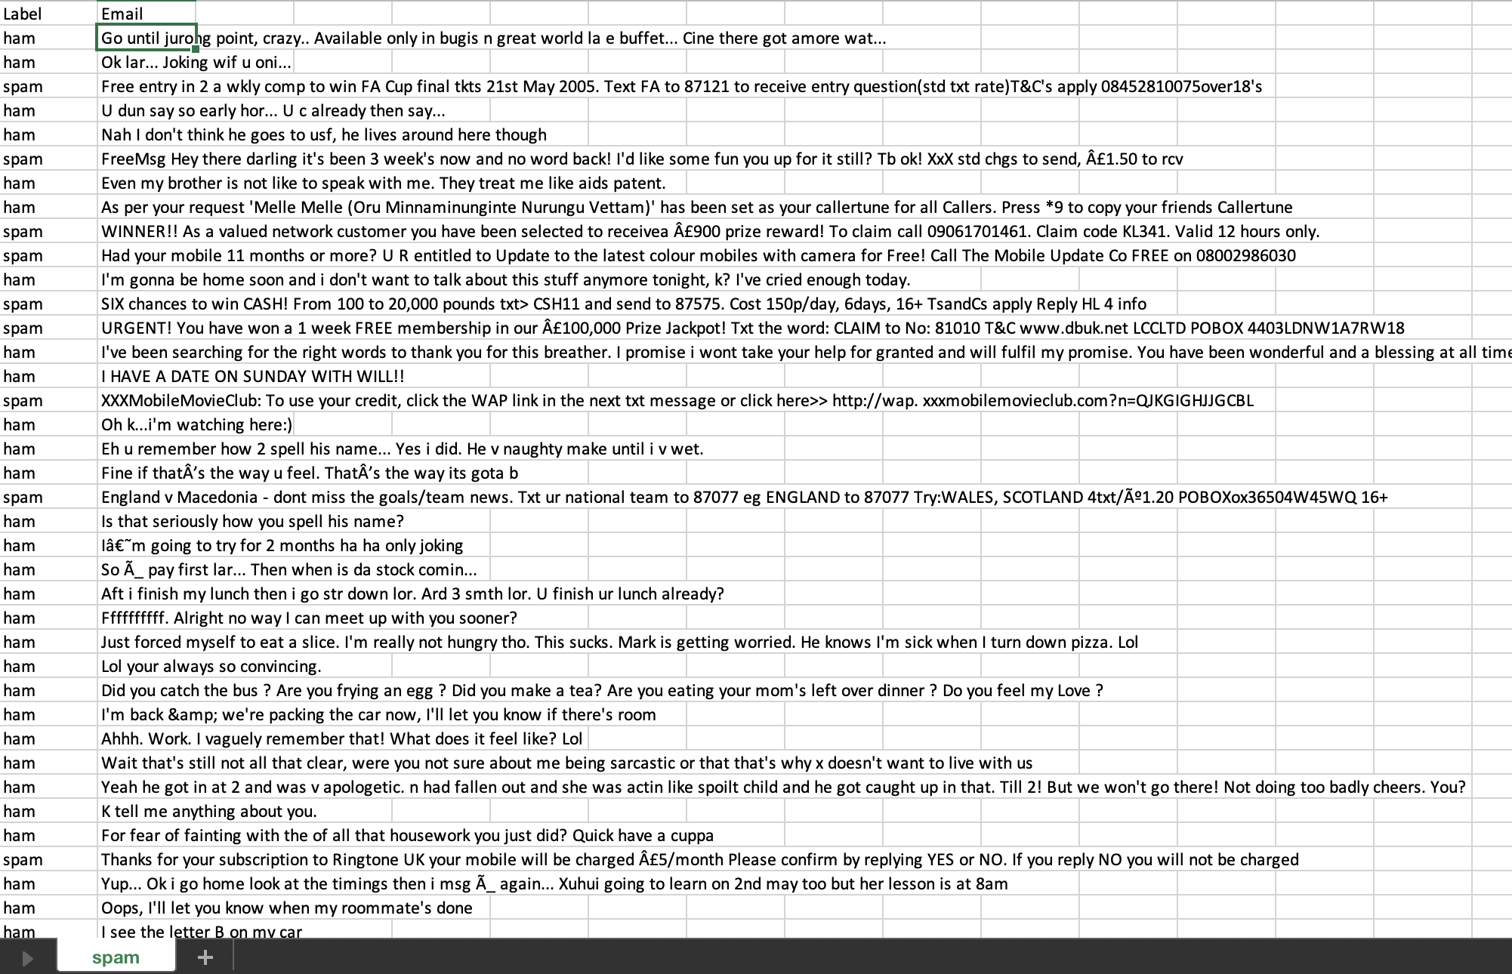


What is Machine Learning?
Machine Learning is the field of study that gives computers the ability to learn without being explicitly programmed (Arthur Samuel, 1959).
A computer program is said to learn from experience E with respect to some task T and some performance measure P, if its performance on T, as measured by P, improves with experience E (Tom Mitchell, 1997).
Experience
Task
Performance measure
Actual
Predicted
Minimize
Minimize

Slide 5
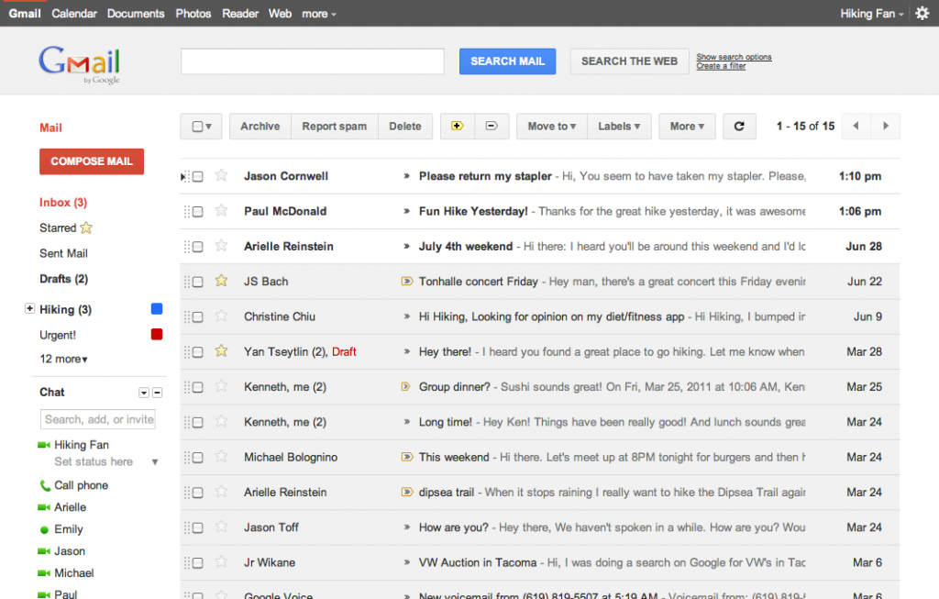
Task (T)
Task: Automatically classify an email as Spam (Bad) or Ham (Good)

Slide 6
Experience (E)
Experience: You are given a dataset with emails labeled Spam (Bad), Ham (Good)

Slide 7
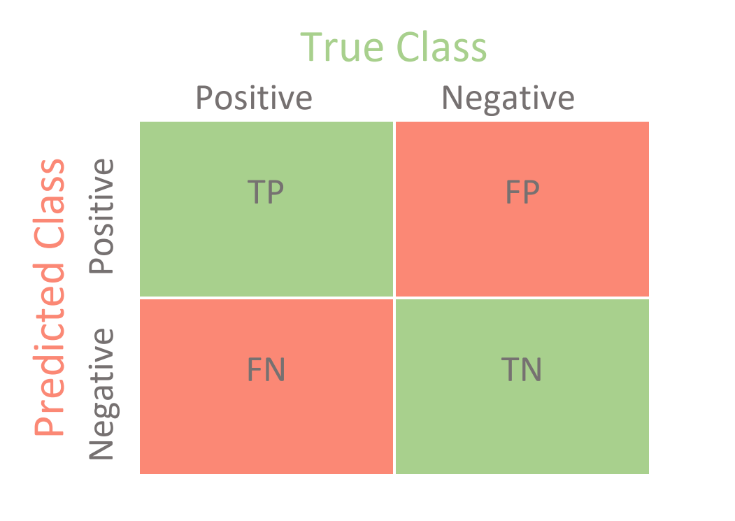
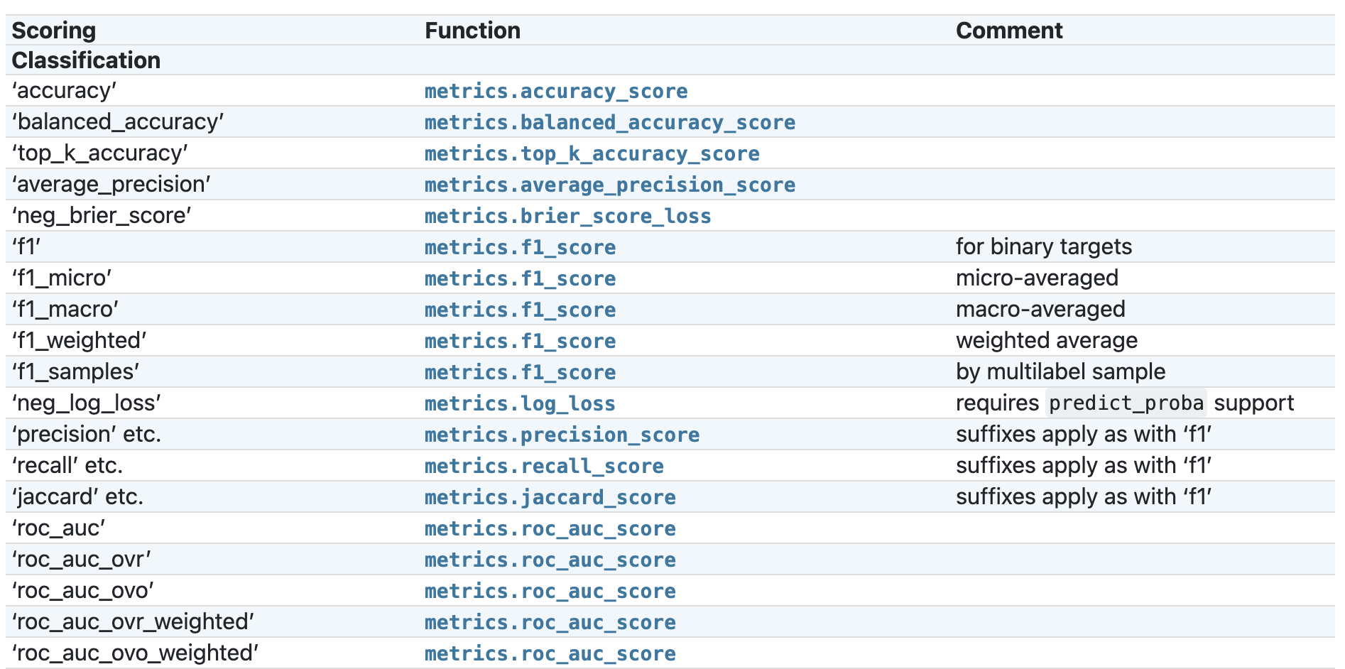
Performance Measure Metrics (P)
Performance Measure: Check how good is your ML algorithm.
Common Classification Metrics
True Positives (TP)
True Negatives (TN)
Confusion Matrix
False Positives (FP)
False Negatives (FN)
Scikit-Learn Classification Metrics

Slide 8
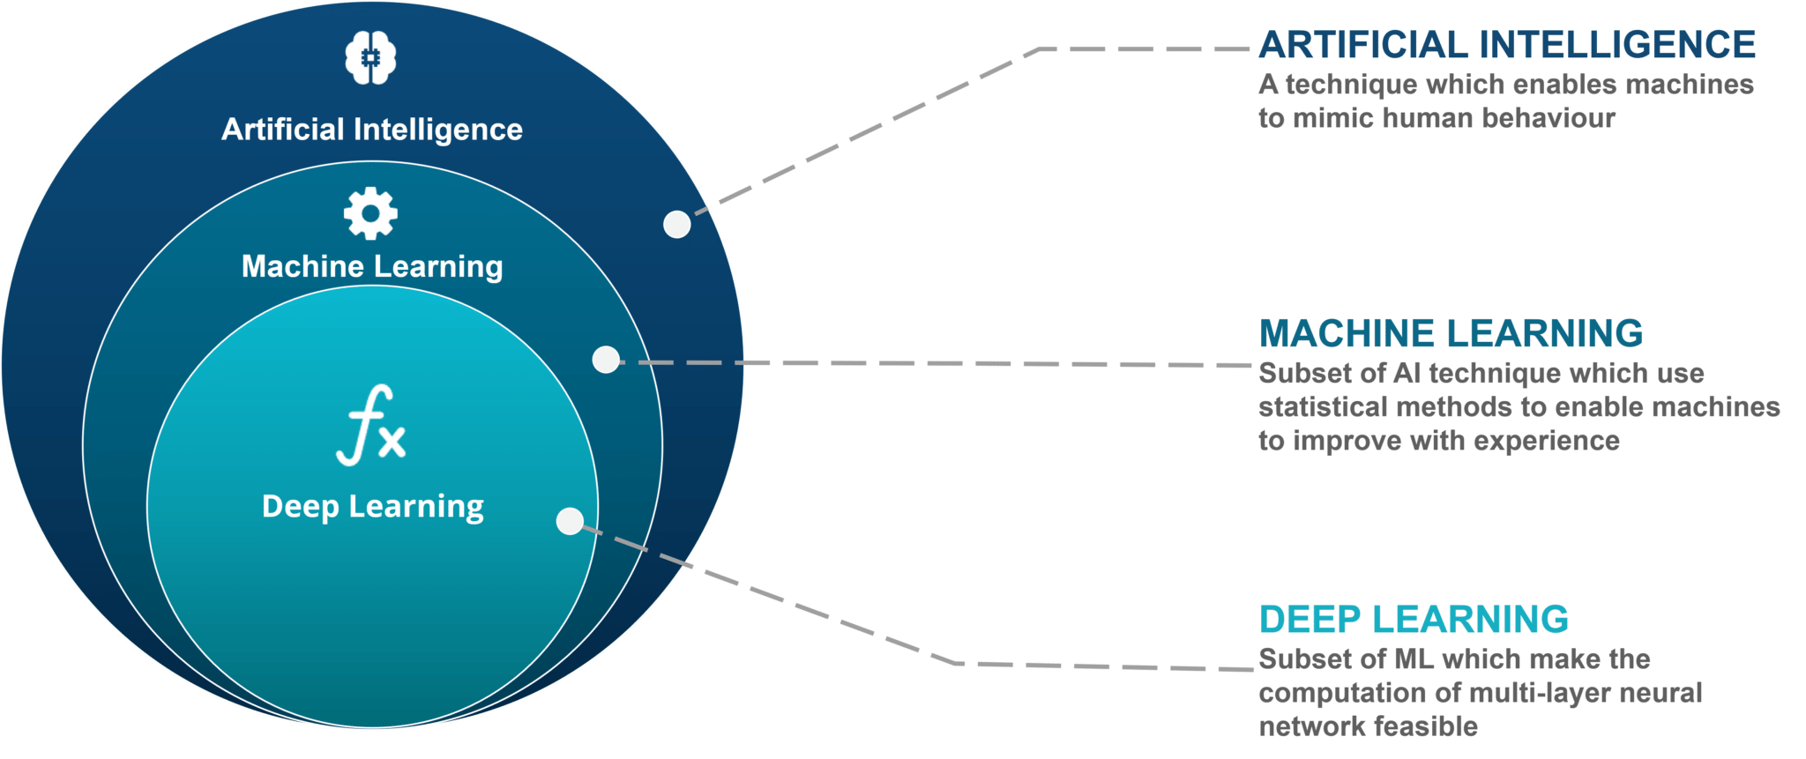
Machine Learning | AI | Deep Learning

Slide 9
Machine Learning Tasks

Slide 10





Course Expectations
Will I be programming?
Hard work?
Math and Statistics?
Research on your own?

Slide 11

Agenda
Introduction to Python for ML:

